Slide 1
A TEST · NOT A RULING
What if the minimal mark
became the mark, and the rest
became the pattern?
The Quintessence steps down a ladder of three. The middle tier — the core and its five petals — is the one that survives at every size. This tests promoting it to the primary mark and working the discarded facets up into a pattern kit.

Slide 2
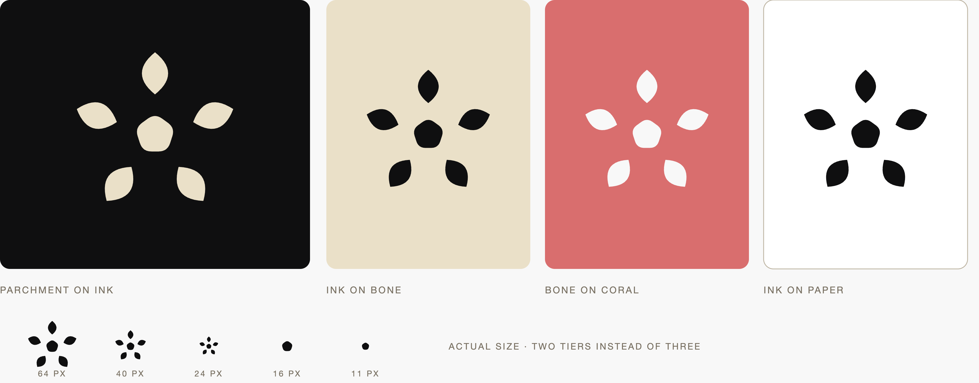
Five Points Digital Studio
The rosette test
2026
pg 2
The rosette
Five golden-rhombus petals bowed into leaves, around a rounded pentagon core. Every constant of the law survives: five-fold at seventy-two degrees, the phi morpheme, the core at thirteen, the corner radius, one colour per rendering.

Slide 3
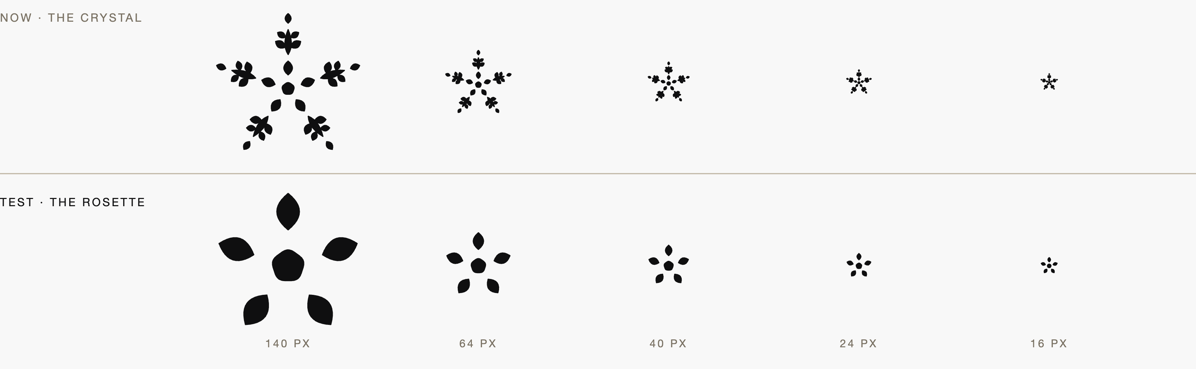
Five Points Digital Studio
The rosette test
2026
pg 3
It holds where
the crystal fails
The crystal is a smudge by forty pixels. The rosette is still a rosette at sixteen, and the core alone carries below that. Three tiers become two.

Slide 4
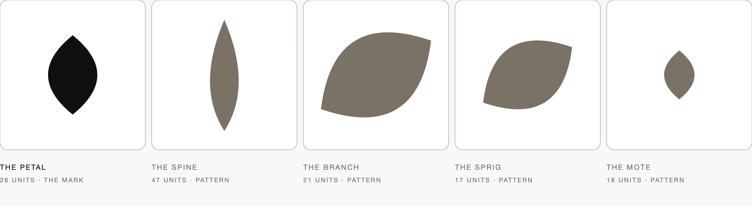
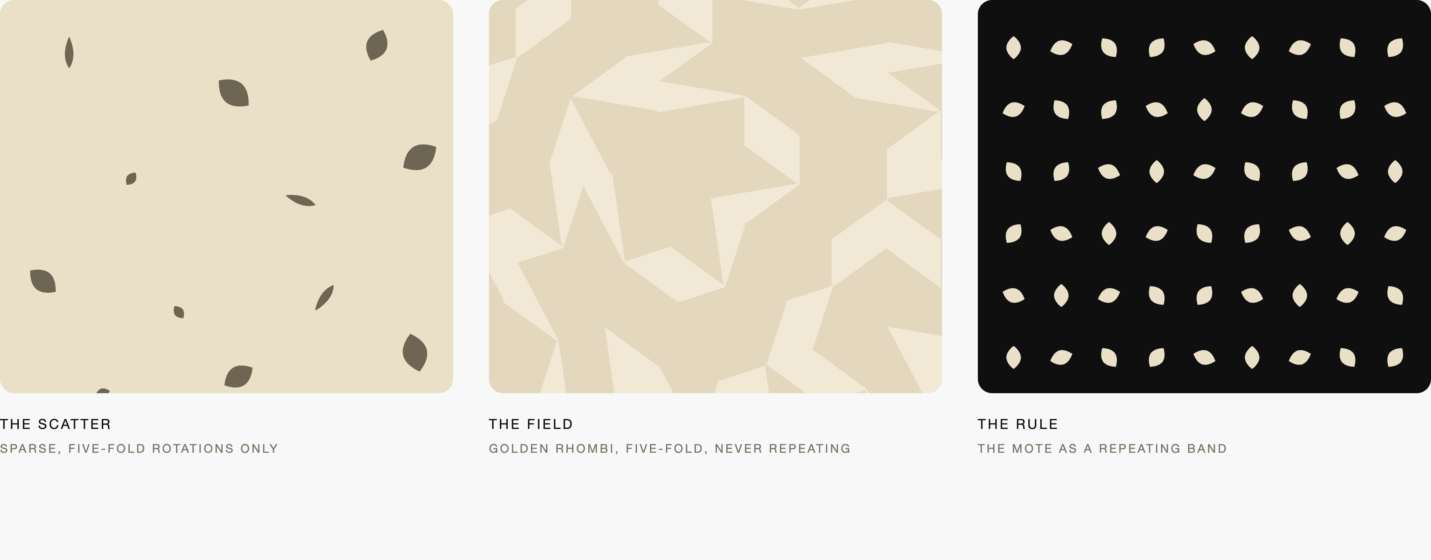
Five Points Digital Studio
The rosette test
2026
pg 4
The rest becomes
the pattern
The spine, the two branch pairs and the mote leave the mark and become a kit of four leaves at their Fibonacci lengths. The brand gains a texture layer it does not currently have.

Slide 5
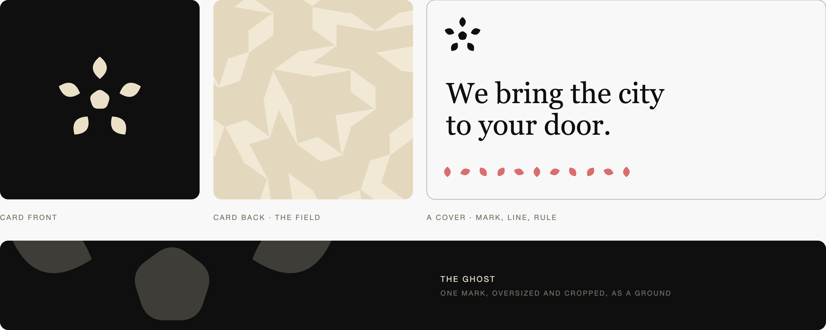
Five Points Digital Studio
The rosette test
2026
pg 5
The field is a Penrose tiling
Five-fold symmetry cannot tile a plane periodically. Built from the same golden rhombus, the field never repeats — which is the one-of-one promise made literal.
The generative promise moves. The mark becomes fixed and canonical; the pattern carries the variance, one issued field per commission. A stable mark for recognition, a variable ground for expression.

Slide 6
Five Points Digital Studio
The rosette test
2026
pg 6
What it costs
It gains
It costs
It keeps
Legibility at every size the brand actually uses — the favicon, the avatar, the nav glyph, the signature.
A pattern system where there is none: four leaves, a scatter, a field, a rule.
The snowflake reading goes, and with it the winter cliché the brief banned outright.
It reads warmer. A rosette suits the Porch in a way a crystal never did.
The Fibonacci descent leaves the mark. Twenty-six, twenty-one, eighteen, seventeen now lives only in the pattern kit.
The mark loses density, and with it some of the commissioned feel that justified the marque register.
Nearest-neighbour risk. Five petals round a centre is a common figure; the particularity is the rhombus petal and the pentagon core, but at a glance it can read as a generic bloom. This wants a trademark knockout before anything is ruled.
Five-fold at seventy-two degrees. The golden rhombus as the only morpheme. The pentagon core at thirteen. The corner radius. The leaf bow. One colour per rendering, and the four colourways unchanged.
The name. Quintessence is the fifth essence, which a five-petal rosette carries as well as a crystal did.
A third option, and probably the strongest: keep the crystal as a ceremonial mark used large only — the seal, the cover, the certificate — and let the rosette carry every working surface beneath it. Nothing is retired, and each mark does what it is actually good at.

